Slide 1
Modelling the 3rd-order velocity structure function in Finite Re HIT
L. Djenidi¹, R. A. Antonia
School of Engineering, The University of Newcastle, NSW Australia
Fab60: Colloquium Fluid turbulence Applications in Both Industrial and Environmental topics,
9 - 11 July 2019, Marseille, France

Slide 2


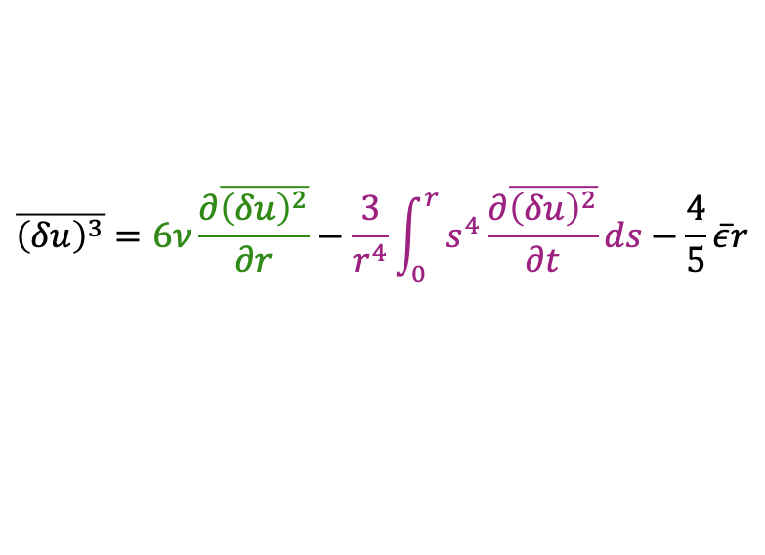

Motivation
Karman-Howarth’s equation is a milestone in the theory of turbulence
written in terms of $\overline{{\left(δu\right)}^{2}}$ and $\overline{{\left(δu\right)}^{3}}$
$$(δu=u\left(x+r,t\right)−u\left(x,t\right))$$
$$\overline{{\left(δu\right)}^{3}}=6ν\frac{∂\overline{{\left(δu\right)}^{2}}}{∂r}−\frac{3}{r^{4}}\int_{0}^{r}{s^{4}\frac{∂\overline{{\left(δu\right)}^{2}}}{∂t}ds}−\frac{4}{5}\overline{ε}r$$
However, it still suffers from the “closure problem”
$$\overline{{\left(δu\right)}^{3}}= ??$$
$\overline{{\left(δu\right)}^{3}}$requires to be modelled

Slide 3





The Closure Model
Existing closure for $\overline{{\left(δu\right)}^{3}}$
Gradient type hypothesis + eddy-viscosity model:
$$\overline{{\left(δu\right)}^{3}}={−ν}_{t}\frac{∂\overline{{\left(δu\right)}^{2}}}{∂r}$$
eddy-viscosity
$$ν_{t}\sim u_{r}l_{r}$$
Length scale
Velocity scale
Common practice:
$$u_{r}\sim {\overline{{\left(δu\right)}^{2}}}^{1/2}$$
leads to $\overline{{\left(δu\right)}^{2}} \sim r^{2/3}$ in the inertial range (Re infinite)
$$l_{r}\sim r$$

Slide 4
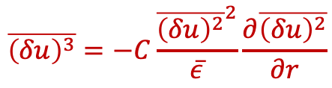





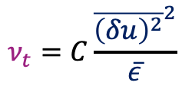
The Closure Model
Present approach
Gradient type hypothesis + eddy-viscosity model:
$$\overline{{\left(δu\right)}^{3}}={−ν}_{t}\frac{∂\overline{{\left(δu\right)}^{2}}}{∂r}$$
$$u_{r}\sim {\overline{{\left(δu\right)}^{2}}}^{1/2}$$
$$ν_{t}\sim u_{r}l_{r}$$
$$l_{r}\sim u_{r}^{3}/\overline{ε}$$
(?)
Richardson cascade: energy flux = $\overline{ε}\sim u_{r}^{3}/l_{r}$
$$ν_{t}=C\frac{{\overline{{\left(δu\right)}^{2}}}^{2}}{\overline{ε}}$$
$$\overline{{\left(δu\right)}^{3}}=−C\frac{{\overline{{\left(δu\right)}^{2}}}^{2}}{\overline{ε}}\frac{∂\overline{{\left(δu\right)}^{2}}}{∂r}$$

Slide 5




The Closure Model
Present approach
Inertial range:
$$\overline{{\left(δu\right)}^{3}}=−C\frac{{\overline{{\left(δu\right)}^{2}}}^{2}}{\overline{ε}}\frac{∂\overline{{\left(δu\right)}^{2}}}{∂r}=\frac{4}{5}\overline{ε}r$$
$\overline{{\left(δu\right)}^{2}}={\left(\frac{6}{5C}\right)}^{1/3}{\left(\overline{ε}r\right)}^{2/3}$
Not too surprising since global scale invariance is assumed (via the Richardson cascade)
Using $\overline{{ \left(δu\right)}^{2}}=C_{K}{\left(\overline{ε}r\right)}^{2/3}$
$$C=\frac{6}{5C_{K}^{3}}$$
Kolmogorov’s constant

Slide 6




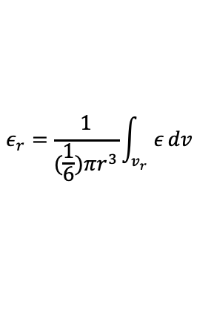
The Closure Model
Present approach
But what if global scale invariance is broken due to the so-called internal intermittency?
$\overline{ε}$ is replaced by $ε_{r}$
$$ε_{r}=\frac{1}{(\frac{1}{6})πr^{3}}\int_{v_{r}}{ε}dv$$
Local averaged energy dissipation
Multifractal model for the moments of $ε_{r}$
$$\overline{ε_{r}}\sim \overline{ε}$$
$$\overline{ε_{r}^{q}}\sim {\overline{ε}}^{q}{\left(\frac{r}{L}\right)}^{τ_{q}}$$

Slide 7
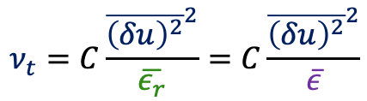
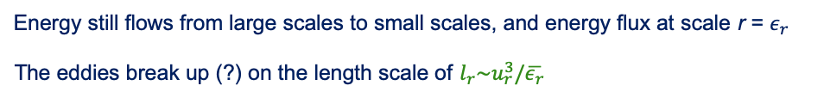






The Closure Model
Present approach
But what if global scale invariance is broken due to the so-called internal intermittency?
Energy still flows from large scales to small scales, and energy flux at scale r = $ε_{r}$
The eddies break up (?) on the length scale of $l_{r}\sim u_{r}^{3}/\overline{ε_{r}}$
$$u_{r}\sim {\overline{{\left(δu\right)}^{2}}}^{1/2}$$
$$ν_{t}=C\frac{{\overline{{\left(δu\right)}^{2}}}^{2}}{\overline{ε_{r}}}=C\frac{{\overline{{\left(δu\right)}^{2}}}^{2}}{\overline{ε}}$$
$$ν_{t}\sim u_{r}l_{r}$$
$$l_{r}\sim u_{r}^{3}/\overline{ε_{r}}$$
$$\overline{{\left(δu\right)}^{3}}=−C\frac{{\overline{{\left(δu\right)}^{2}}}^{2}}{\overline{ε}}\frac{∂\overline{{\left(δu\right)}^{2}}}{∂r}$$
(Nothing is known about $\overline{{\left(δu\right)}^{2}}$)
Same as before
$$\overline{{\left(δu\right)}^{2}}\sim {\left(\overline{ε}r\right)}^{2/3}$$

Slide 8

Model Testing
Use of DNS data for steady state HIT
[18] T. Gotoh, D. Fukayama, and T. Nakano, Phys. Fluids 14, 1065 (2002).
[19] T. Ishihara, T. Gotoh, and Y. Kaneda, Annu. Rev. Fluid Mech. 41, 165 (2009).
[20] S. R. Yoffe, arXiv preprint arXiv:1306.3408 (2013).
For convenience we use $\overline{{\left(δu\right)}^{n}}=S_{n}$
FIG. 1. Distributions of S₂/($\overline{ε}$r)^{2/3} in forced HIT. Dotted lines: [19], Re_{λ} = 257, 1131; Solid lines: [18], Re_{λ} = 284, 460; Dashed lines: [20], Re_{λ} = 177, 335,

Slide 9


Model Testing
Model: $\overline{{\left(δu\right)}^{3}}=−\frac{6}{5C_{K}^{3}}\frac{{\overline{{\left(δu\right)}^{2}}}^{2}}{\overline{ε}}\frac{∂\overline{{\left(δu\right)}^{2}}}{∂r}$
$$r\sim 30η$$
FIG. 2. DNS and calculated distributions of (-S₃/($\overline{ε}$r)) in forced HIT:
(a): [20], Re_{λ} = 177 and 335; Solid lines: DNS. Symbols: model with C_{K} = 2.05.
(b): [19] Re_{λ} = 257 and 1131.
Inset: same as in main figure (b) but with C_{K} = 2.15. (red), C_{K} = 2.35 (blue).

Slide 10



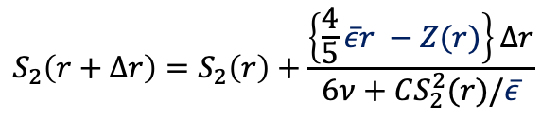

Model Testing
Solving: $6ν\frac{∂\overline{{\left(δu\right)}^{2}}}{∂r}−\overline{{\left(δu\right)}^{3}}+Z\left(r\right)=\frac{4}{5}\overline{ε}r$
$$Z\left(r\right)= \frac{2}{35}\overline{ε}k_{f}^{2}r^{3}$$
$$S_{2}\left(r+∆r\right)=S_{2}\left(r\right)+\frac{\left\{\frac{4}{5}\overline{ε}r −Z(r)\right\}∆r}{6ν+CS_{2}^{2}(r)/\overline{ε}}$$
Start calculations at $r=30η$
Use of DNS data for $ν$ and $\overline{ ε}$as input

Slide 11
Model Testing
Solving: $6ν\frac{∂\overline{{\left(δu\right)}^{2}}}{∂r}−\overline{{\left(δu\right)}^{3}}+Z\left(r\right)=\frac{4}{5}\overline{ε}r$ over the range $r_{c}≤r≤∞$
FIG. 3. Calculated S₂/($\overline{ε}$r)^{2/3} in forced HIT using the modelled equation. Dashed line: DNS [20], Re_{λ} = 177 and 335; solid lines: calculation based on modelled equation with C_{K} = 2.075 and k_{f} = 1.65. Long dashed lines: k_{f} = 0.

Slide 12
Model Testing
Solving: $6ν\frac{∂\overline{{\left(δu\right)}^{2}}}{∂r}−\overline{{\left(δu\right)}^{3}}+Z\left(r\right)=\frac{4}{5}\overline{ε}r$over the range $r_{c}≤r≤∞$
FIG. 4. Calculated S₂/($\overline{ε}$r)^{2/3} in forced HIT using (18). Solid lines: calculation based on the modelled equation with C_{K} = 2.275. Dashed line: DNS [19], a: Re_{λ} = 257.
b: Re_{λ} = 1131

Slide 13
Model Testing
Solving: $6ν\frac{∂\overline{{\left(δu\right)}^{2}}}{∂r}−\overline{{\left(δu\right)}^{3}}+Z\left(r\right)=\frac{4}{5}\overline{ε}r$ over the range $0≤r≤∞$
FIG. 5. Calculated S₂/($\overline{ε}$r)^{2/3} in forced HIT over the whole range of r/η. Dashed line: DNS, [20] Re_{λ} = 177; solid lines: calculations using the modelled equation, k_{f} = 1.65, C_{K} = 2.075.

Slide 14




Model Testing
Solving: $6ν\frac{∂\overline{{\left(δu\right)}^{2}}}{∂r}−\overline{{\left(δu\right)}^{3}}+Z\left(r\right)=\frac{4}{5}\overline{ε}r$ over the range $0≤r≤∞$
$$f\left(r\right)=1/{(\frac{r}{r_{c}})}^{p}$$
$$r ≤r_{c}$$
$$f\left(r\right)=1$$
$$r ≥r_{c}$$
FIG. 5. Calculated S₂/($\overline{ε}$r)^{2/3} in forced HIT over the whole range of r/η. Dashed line: DNS, [20] Re_{λ} = 177; solid lines: calculations using the modelled equation, k_{f} = 1.65, C_{K} = 2.075.
f(r) is a bridging function between the dissipative and scaling ranges; p =2/3

Slide 15

Conclusions
Development of a closure model for $\overline{{\left(δu\right)}^{3}}$
$$\overline{{\left(δu\right)}^{3}}=−C\frac{{\overline{{\left(δu\right)}^{2}}}^{2}}{\overline{ε}}\frac{∂\overline{{\left(δu\right)}^{2}}}{∂r}$$
No assumptions are made regarding the behaviour of both $\overline{{\left(δu\right)}^{2}}$ and $\overline{{\left(δu\right)}^{3}}$
When an inertial range exists, the model leads the 2/3 law: $\overline{{\left(δu\right)}^{2}}\sim r^{2/3}$
(regardless of the intermittency phenomenology of $ε$ is used or not)
When used to close transport equation for $\overline{{\left(δu\right)}^{2}}$ for solving this latter in forced HIT we found:
The calculations are in a good agreement with the DNS data at all scales of
motion but in the transition between the dissipative and scaling ranges.
(a simple bridging function helped improve the calculation in that transition range)
Departure from the 2/3 law is associated with the presence of a large-scale term in
the $\overline{{\left(δu\right)}^{2}}$ equation.

Slide 17




Question time
What if we used the intermittent form for $\overline{{(δu)}^{2}}$ ?
Taking
$$\overline{{(δu)}^{2}}\sim {\left(\overline{ε}r\right)}^{2/3}{\left(\frac{r}{L}\right)}^{f_{2}}$$
$$C(\frac{2}{3}+f_{2})\overline{ε}r{\left(\frac{r}{L}\right)}^{{3f}_{2}}=\frac{4}{5}\overline{ε}r$$
Substitute it in
$$\overline{{\left(δu\right)}^{3}}=−C\frac{{\overline{{\left(δu\right)}^{2}}}^{2}}{\overline{ε}}\frac{∂\overline{{\left(δu\right)}^{2}}}{∂r}=−\frac{4}{5}\overline{ε}r$$
Violation of the 4/5 law, unless $f_{2}$ = 0
Note that the objective of the present work is not to assume a form for $\overline{{(δu)}^{2}}$ in developing the model for $\overline{{\left(δu\right)}^{3}}$

