Slide 1
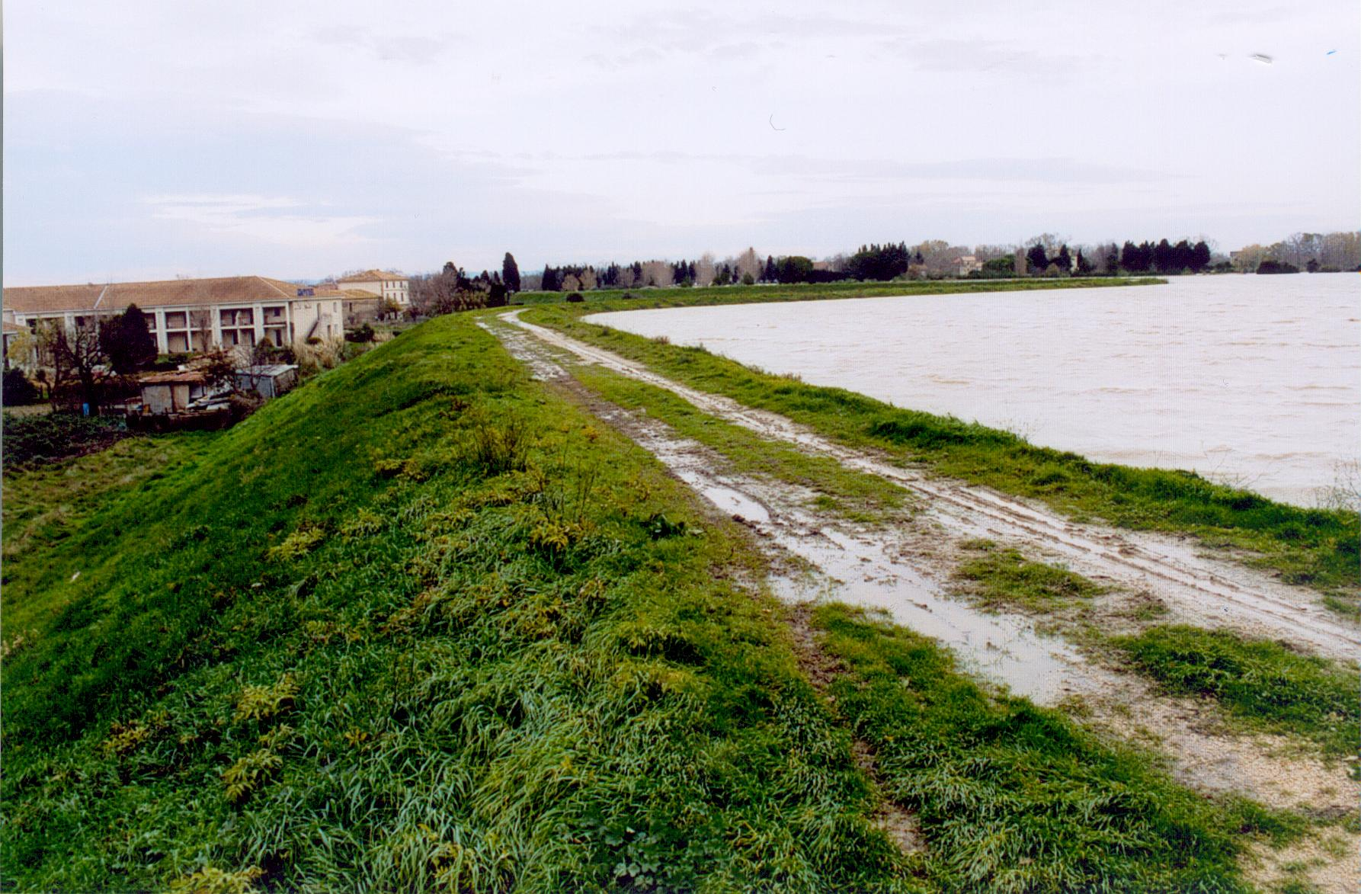
Failure of earth dams and dikes
1
The hazard has two components:
- Natural hazard (the flood)
- Technological hazard (the dike failure)
People living
A dike failure is always more dangerous than the flood itself
Rhône river flooding (dec 2003) - Arles (France)

Slide 2
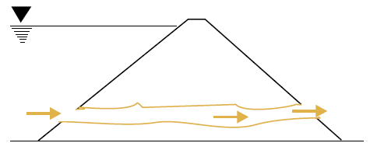
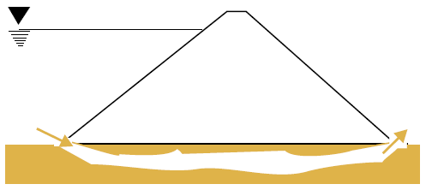
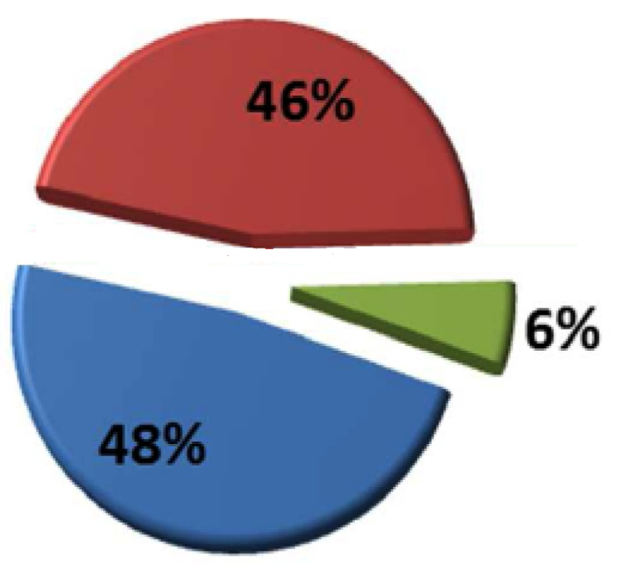
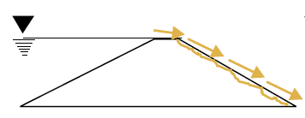
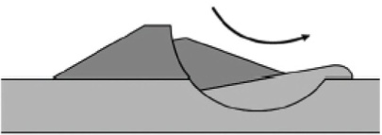
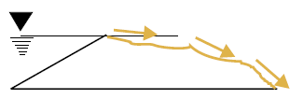
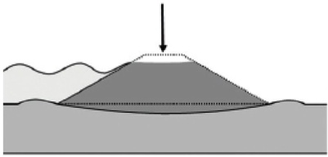
Erosion if the main cause of earth dams and dikes
2
Internal erosion
Overflowing and surface erosion
Mechanical
Instabilities

Slide 3
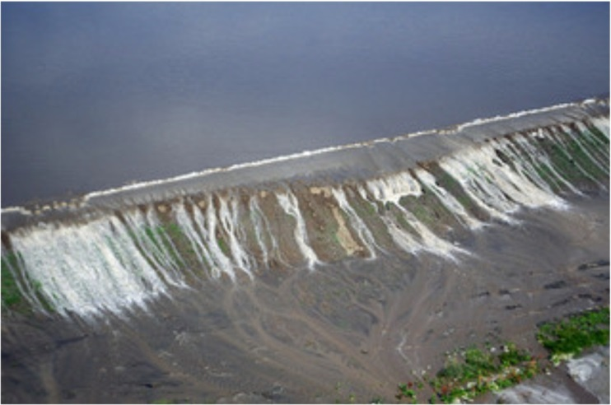
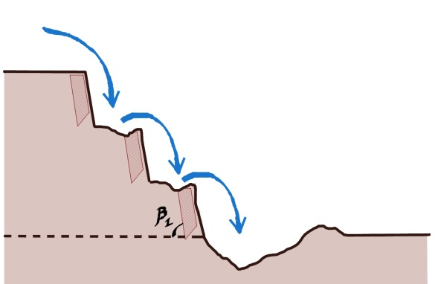
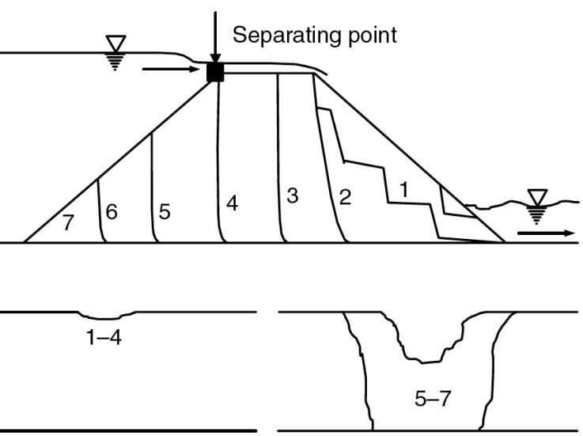
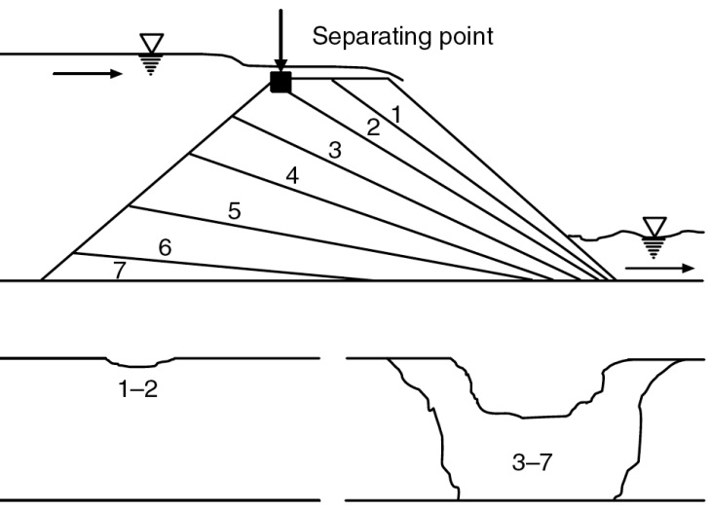
Overflowing (steady overtopping) with soil erosion
3
Missouri (2011)
Headcut erosion
(impinging jet)
Initiation
Development
Initiation
Development
Cohesionless soil
Cohesive soil

Slide 4
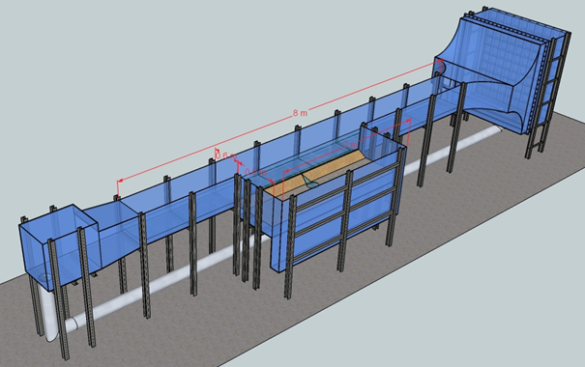
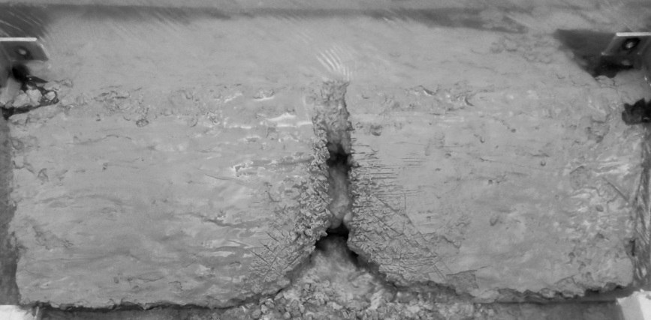
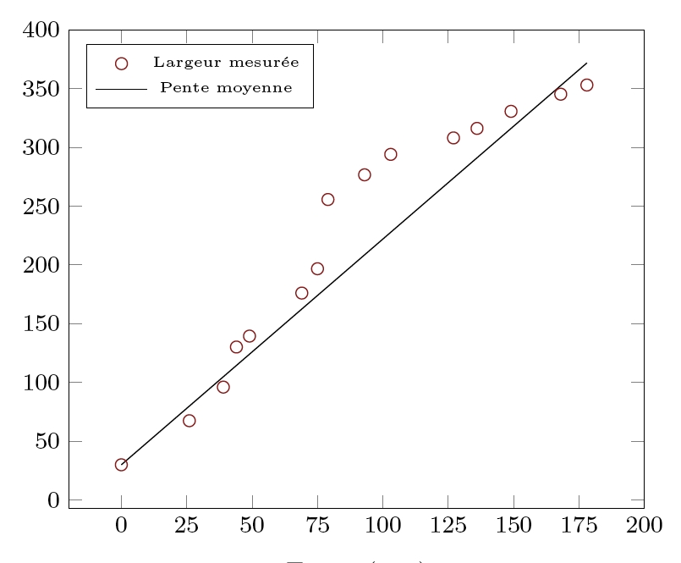
Irphe Small scale testing (G. Charrier PhD thesis)
4
    Head-cut erosion
    The step scorrespond to the construction layers
    Modified Herode Flume to study dike overflowing
    (G. Charrier PhD Thesis)
Breach width (mm)
(G. Charrier, F. Anselmet, M. Amielh, L. Pietri, 2015)
Time (mn)

Slide 5
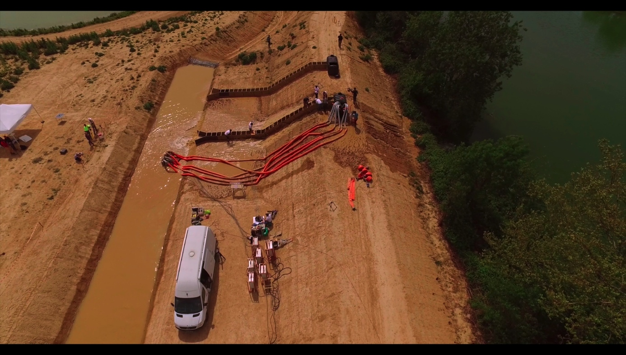
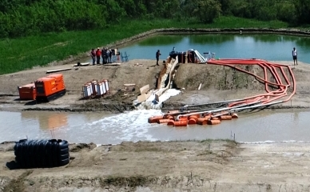
Overflowing Field tests
5
2016 Field tests
(Vidourle river)
2018 Field tests
(Rhône river)

Slide 6
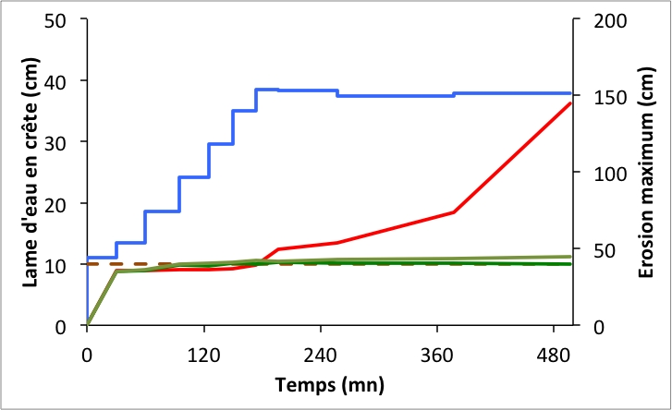
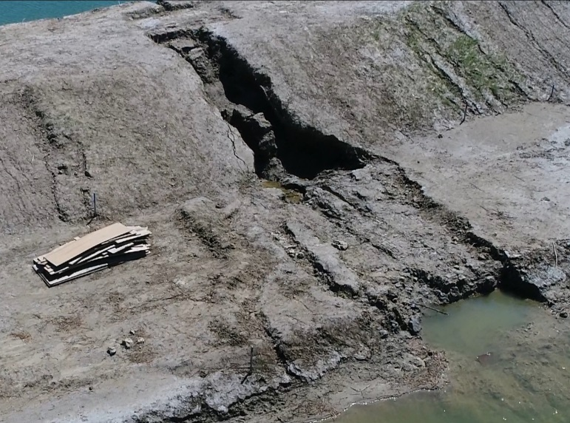
Overflowing Field tests – Example of results
6
    Duration
    Flow rate
    Water level on crest
    Slope
    Vegetal cover
    8h
    0.4 m³/s/mL
    40 cm (rate 15 cm/h)
    2.5/1
    40 cm
Crest water level
Crest water level (cm)
Erodible soil
Maximum erosion (cm)
Resistant soil
The dike after testing
(erodible soil)
Time (mn)

Slide 7
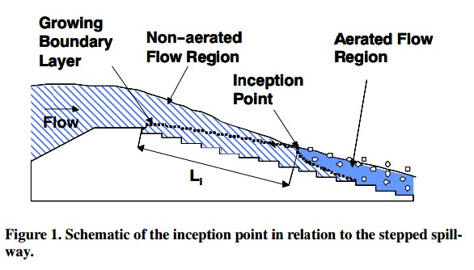
Physics of Overflowing Erosion
7
Head cutting erosion
    Skimming flow over a steep stepped slope
    (turbulent aerated flows)

Slide 8
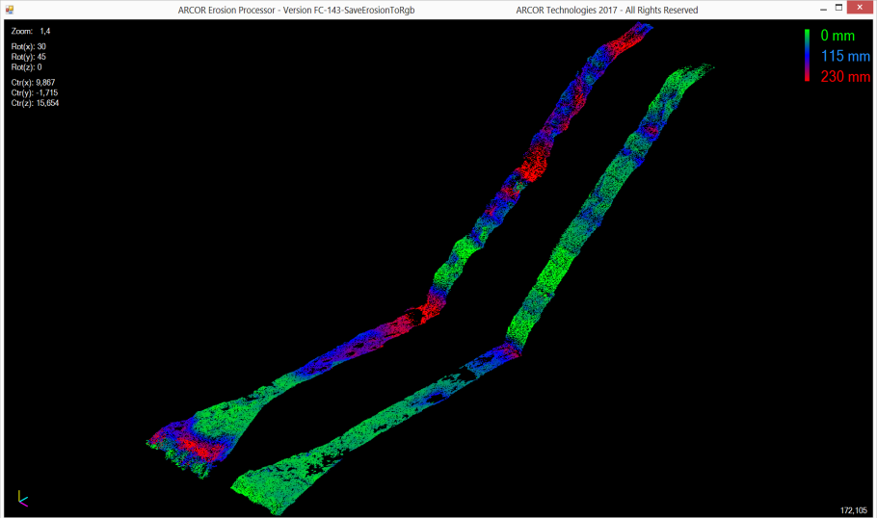
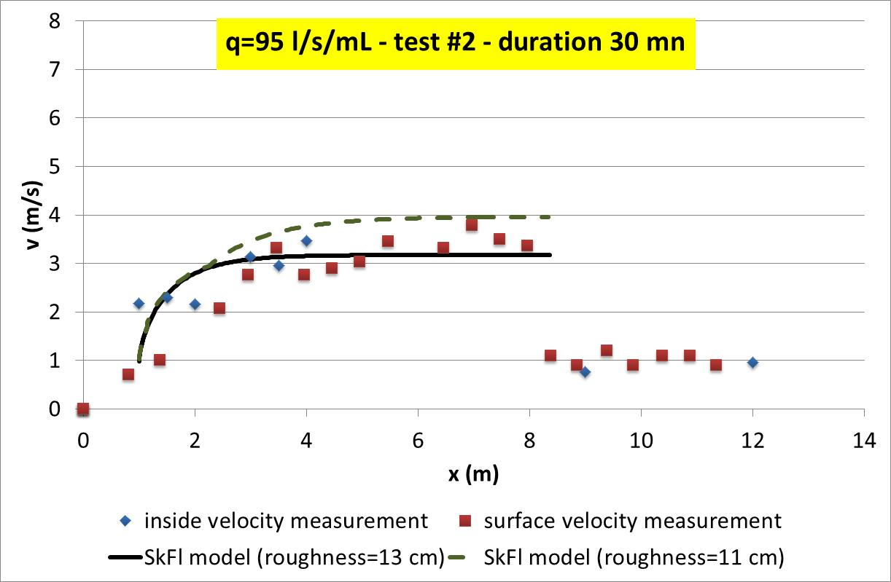
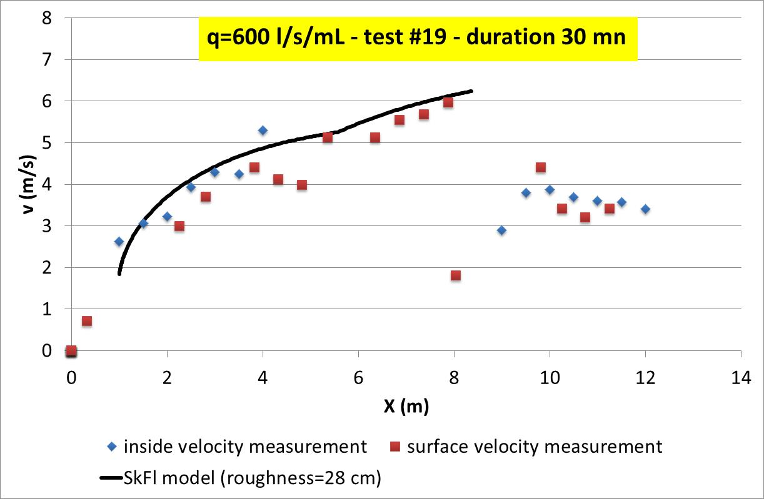
Field tests – Example of results
8
    The Chanson model (1994) is used for measurement analysis
    Erosion depth
    (Lidar scanner)
    Erodible soil
    Resistant soil

Slide 9
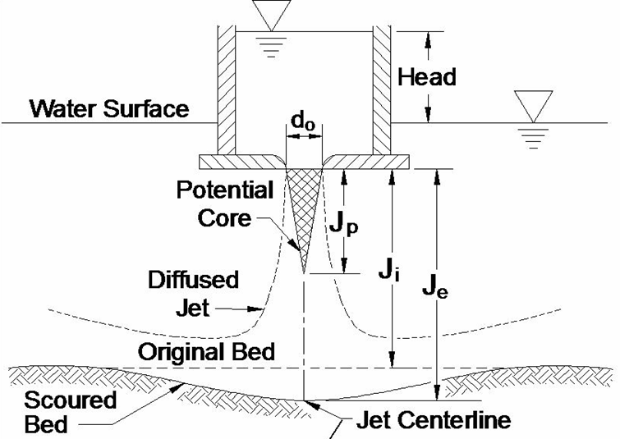
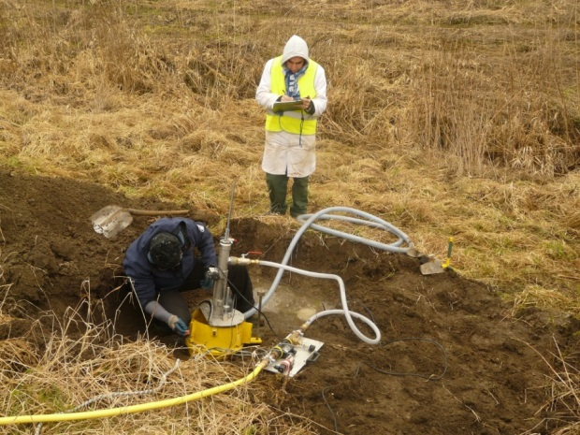
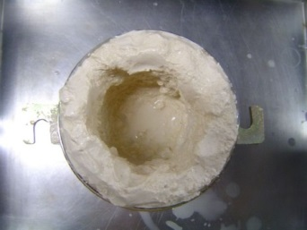
Impinging Jet with Erosion (Jet Erosion test)
9
k_{d}
Scour depth (mm)
Erosion Rate (m/s)
1
Time (s)
Shear stress (Pa)

Slide 10
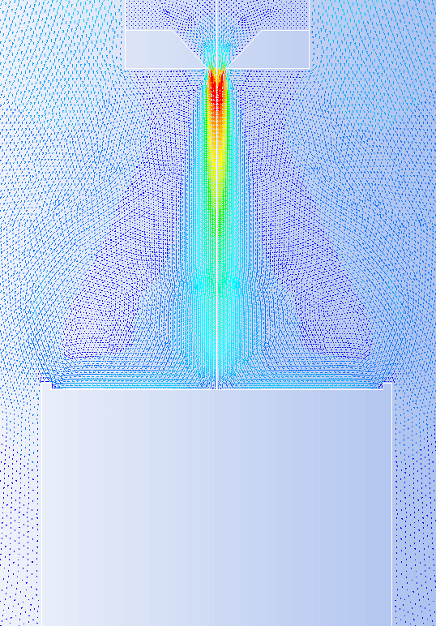
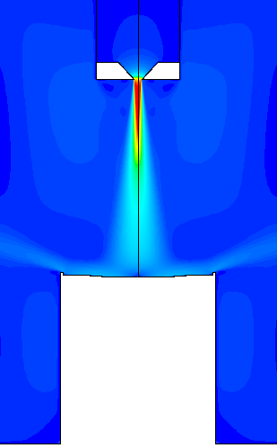
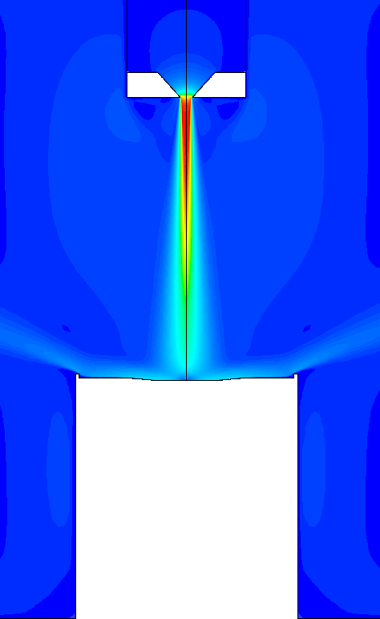
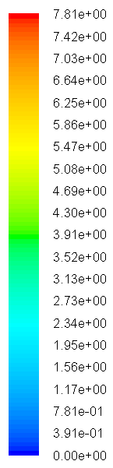
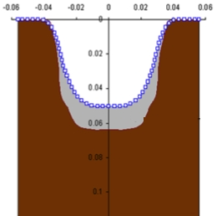
Impinging Jet with Erosion (Jet Erosion test)
10
    CFD modeling with wall erosion and remeshing
    (F. Mercier PhD Thesis)
Mercier F., Bonelli S., Anselmet F. et al., J. Hydraul. Eng. ASCE, 2014
Mercier F., Bonelli S., Anselmet F. et al., Eur. J. Mech. B/Fluids, 2015
    non cohesive soil
    cohesive soils
    measurement
    measurement

Slide 11
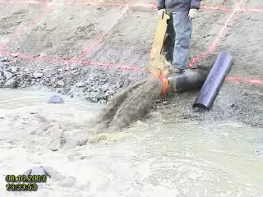
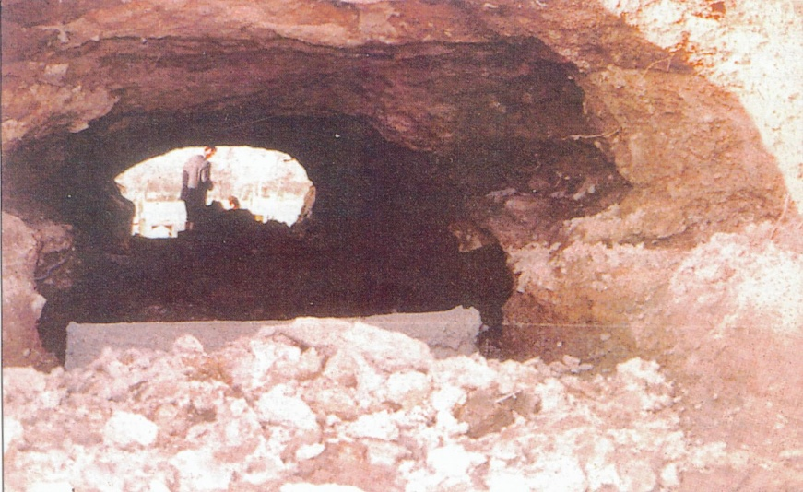
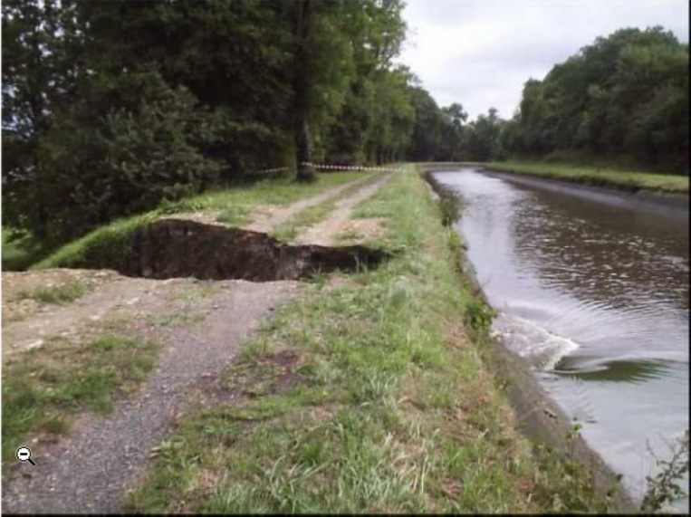
Pipe Flow Wih Erosion
11
St Julien des Landes 1969
2001 Marne/Rhin Canal
    Field Test in Norway (FP5 Project, 2003)

Slide 12
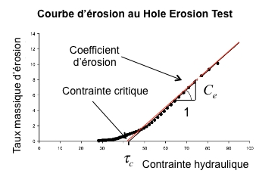
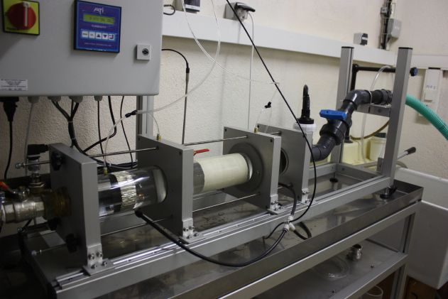
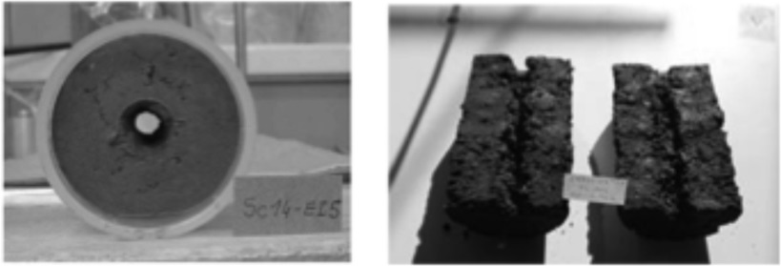
Pipe flow with erosion (Hole Erosion test)
12
Erosion Rate (x10 ⁻³ m/s)
Shear stress (Pa)

Slide 13
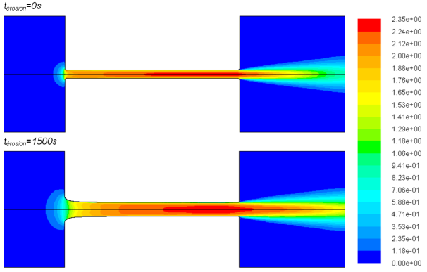
Pipe flow with erosion (Hole Erosion test)
13
    CFD modeling with wall erosion and remeshing (F. Mercier PhD Thesis)
    Pressure drop (Pa)
    Measurement
    Time (s)
Mercier F., Bonelli S., Anselmet F., et al., Acta Geotechnica (2015)

