Slide 1
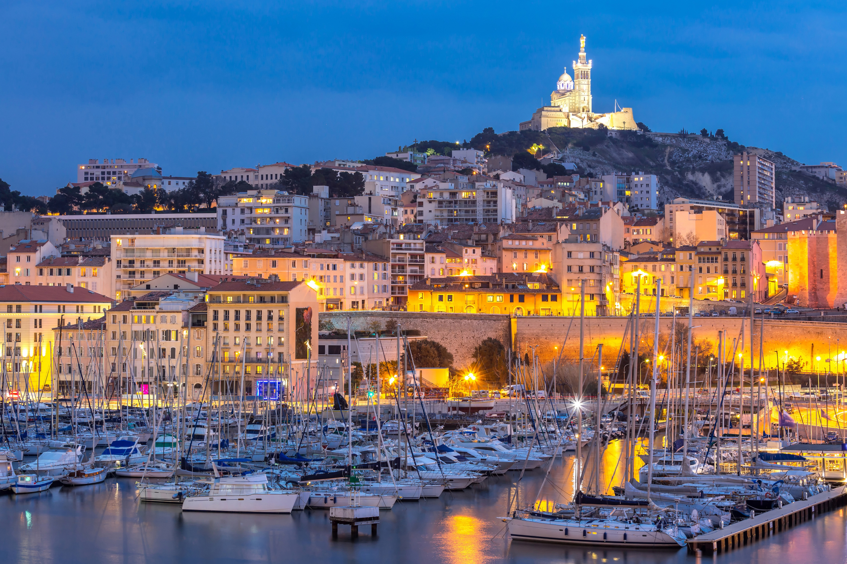


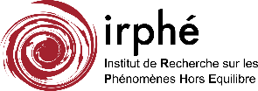


Water round jet atomization of a large-scale pressure-atomized spray
F. FELIS, S. TOMAS, A. VALLET, M. AMIELH, F. ANSELMET
Fluid turbulence Applications in Both Industrial and ENvironmental topics
9 - 11 July 2019, Marseille, FRANCE

Slide 2
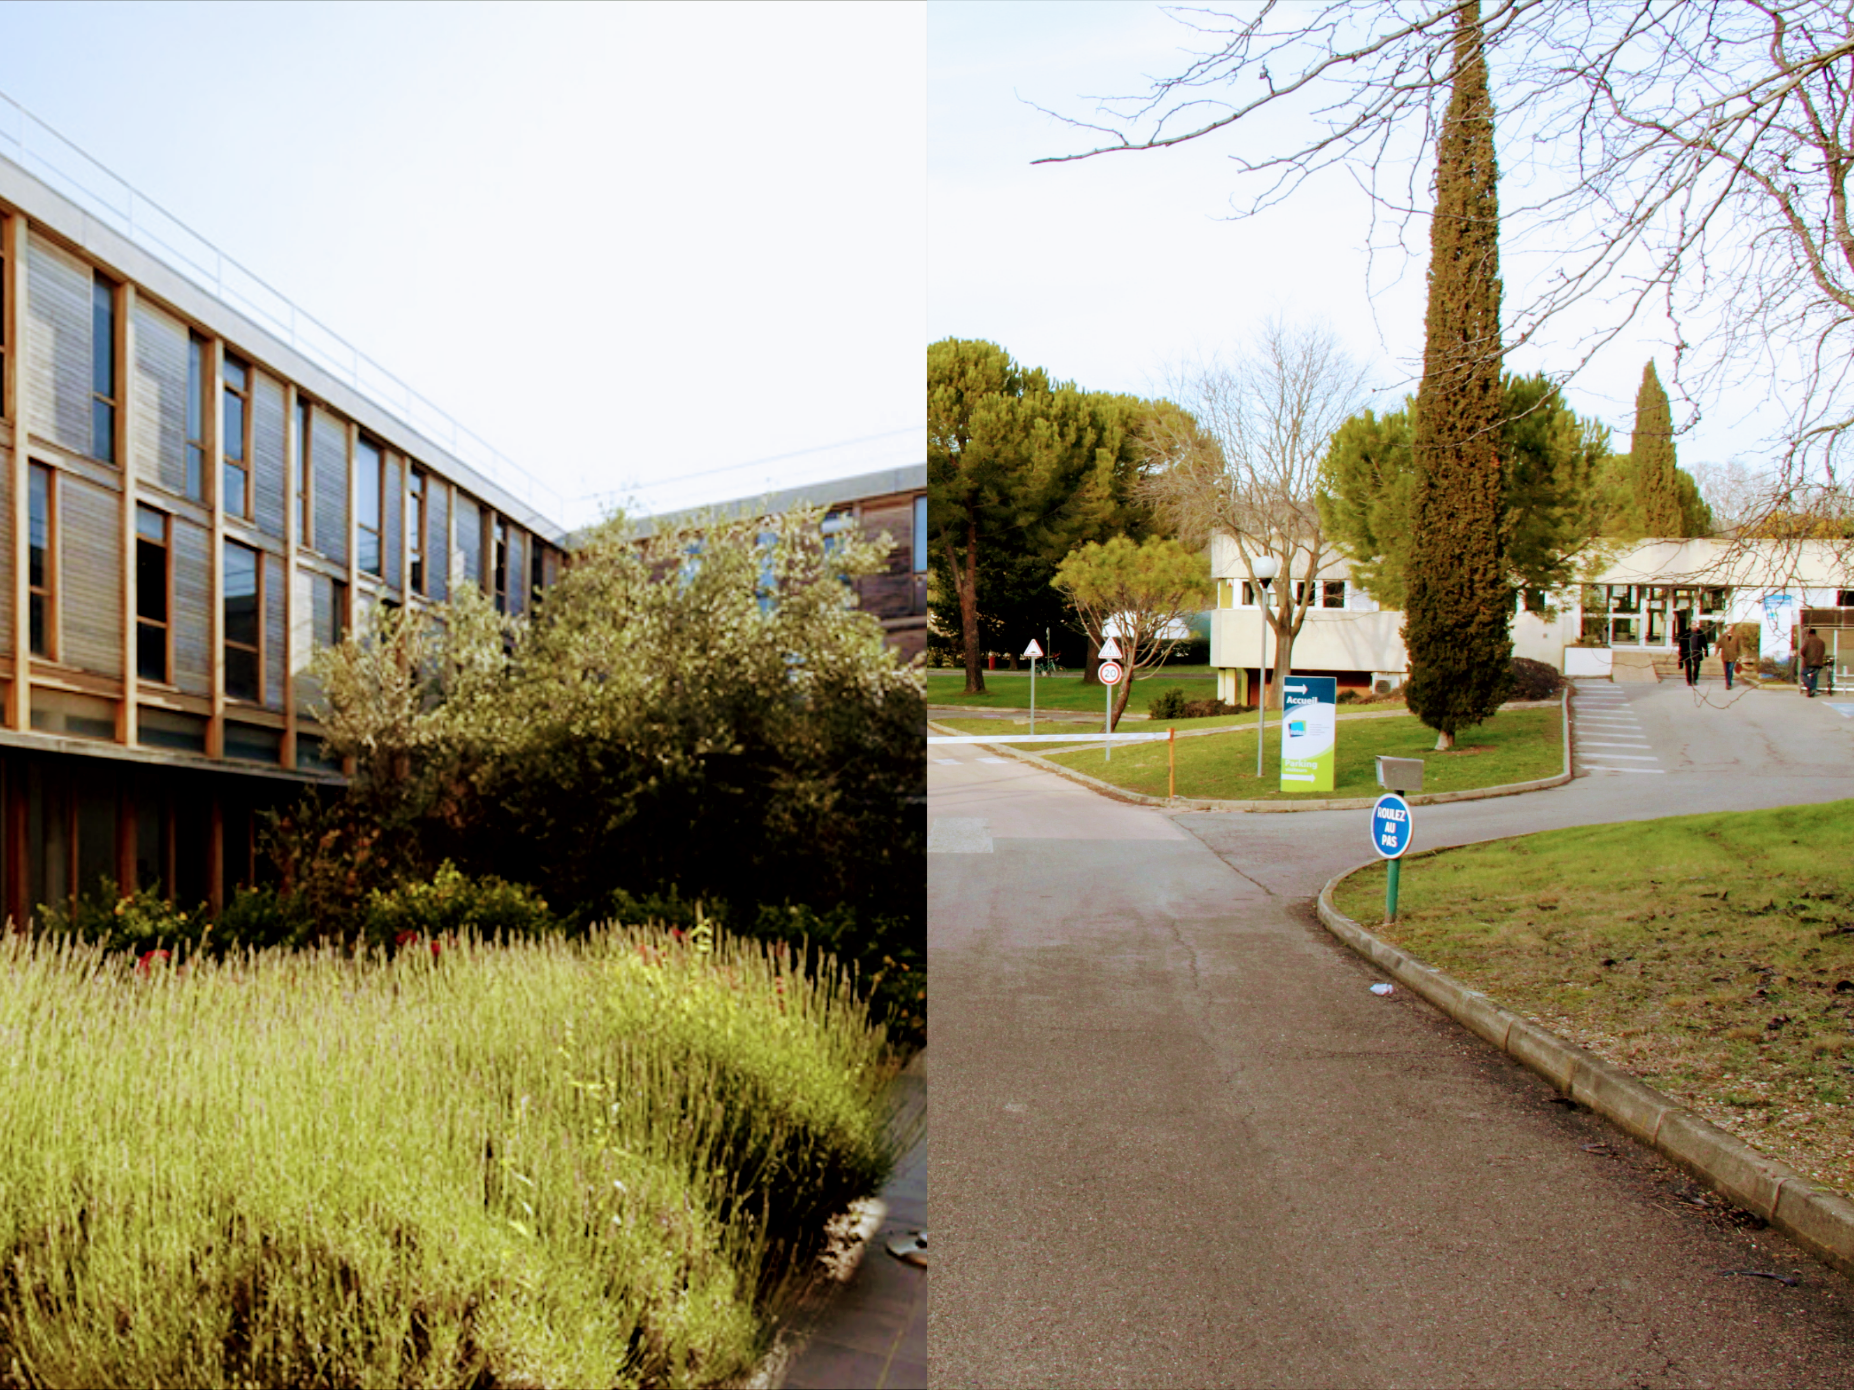




BASED ON A DOCTORAL THESIS
Doctoral School «Engineering Sciences: Mechanics, Physics, Micro and Nanoelectronics»
Specialty : «Physics and Mechanics of Fluids»
Aix-Marseille University (AMU) − École Centrale de Marseille (ECM)
Marseille:
IRPHE - UMR 7342
Turbulence team
Fabien ANSELMET
Muriel AMIELH
Montpellier:
IRSTEA - UMR Geau & ITAP
OPTIMISTE & PEPS teams
Séverine TOMAS
Ariane VALLET
Financing: «CONICYT PFCHA/DOCTORADO BECAS CHILE/2012 - 72130475»
2012—2017

Slide 3
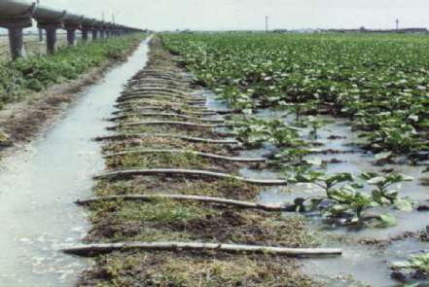
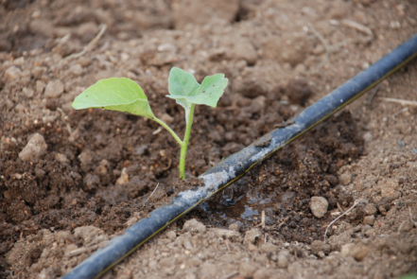
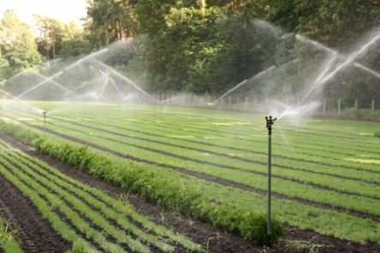
General Context
Sprinkler Irrigation
Water consumption and irrigation
Agriculture accounts for 70% of fresh water withdrawals, up to more than 90% in some developing countries
Uniformity
Furrow irrigation
Impact on ground or plant
Losses due to drift and evaporation
Micro-irrigation
Can we predict the droplets formation and dispersion?
N. Kadem (2005): Big gun
M. Hendawi (2006): Interaction with atmosphere
C. Stevenin (2012): Sprinkler
F. Felis (2017): Modeled nozzle
→ Optimize water consumption in sprinkler irrigation
Sprinkler irrigation

Slide 4
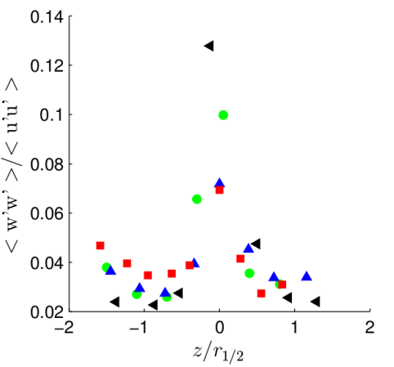

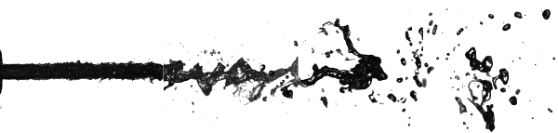
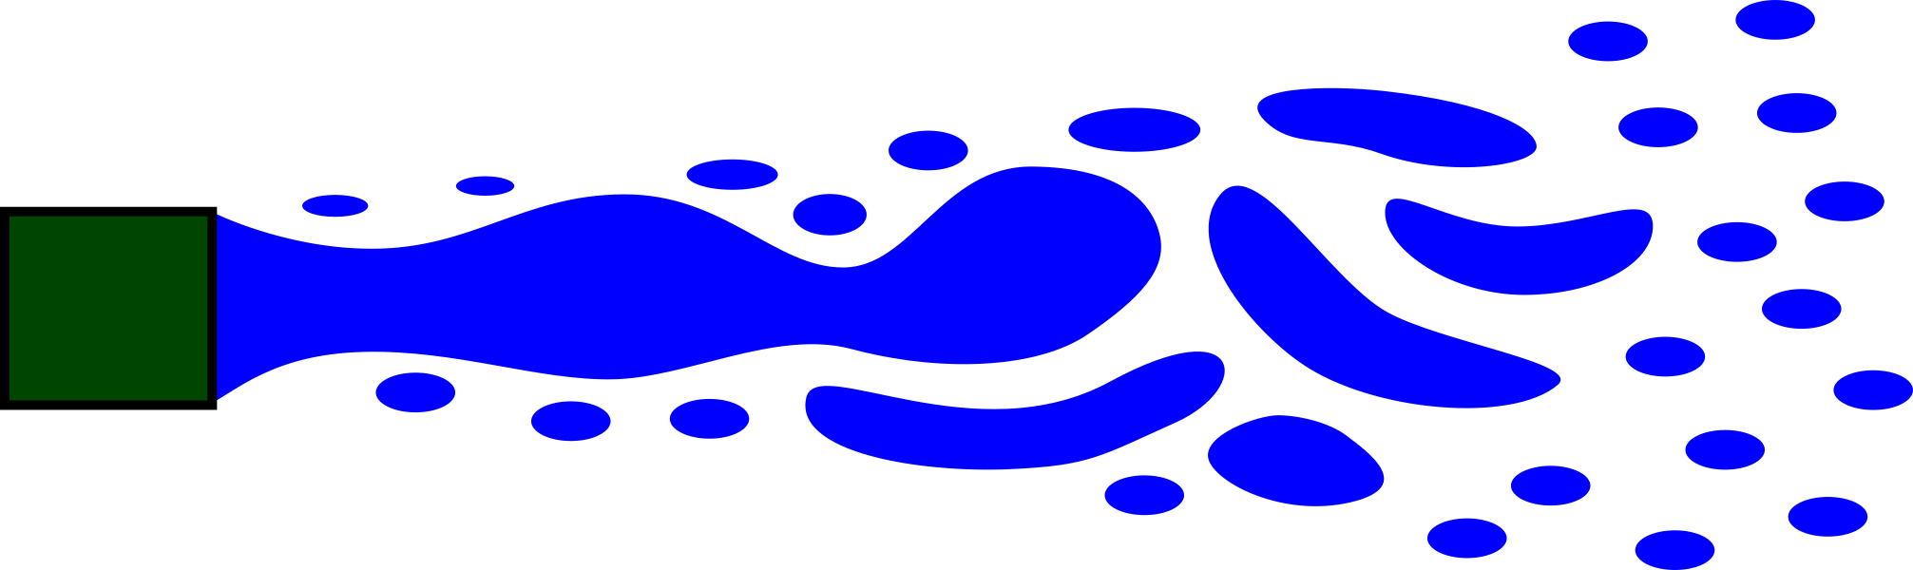
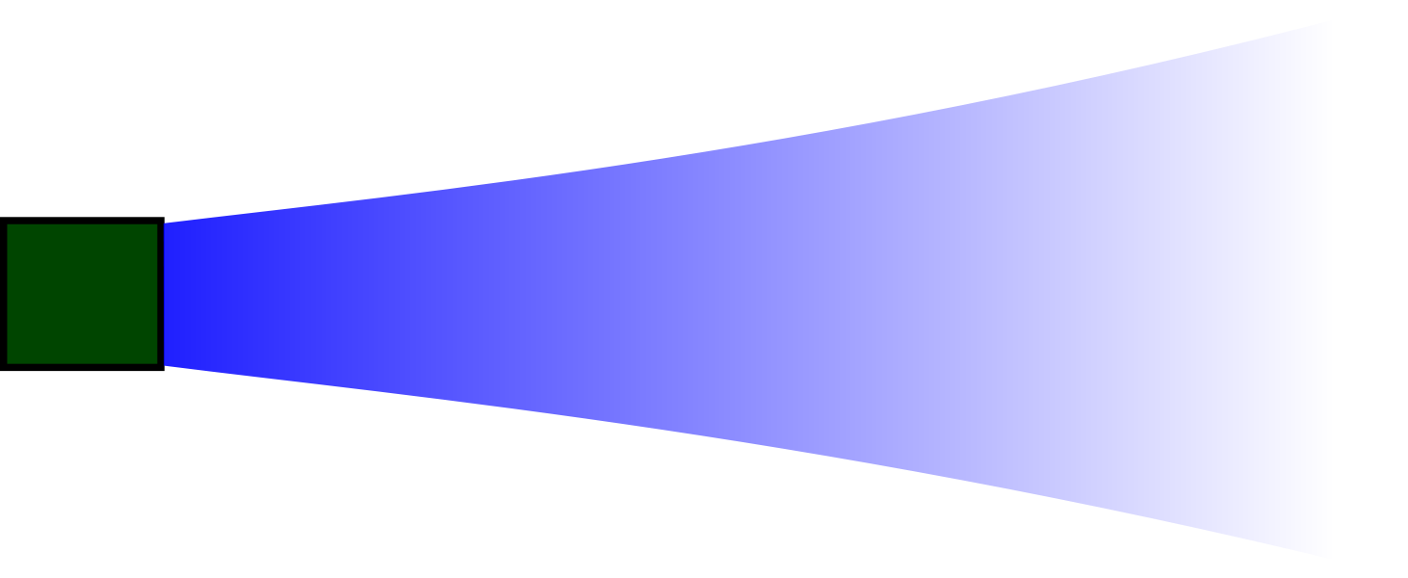
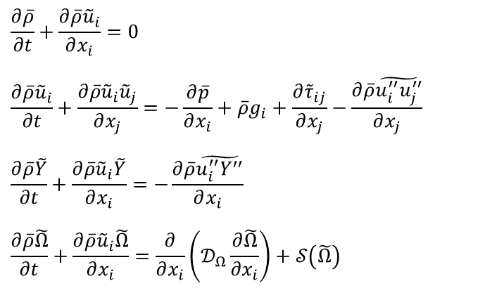

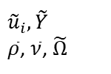
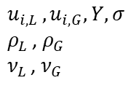


Sprinkler jet atomization
Experimental and numerical approaches
Experimental approach : Optical techniques (LDV/DTV/OP)
Commercial sprinkler RB46:
Round nozzle
Horizontal direction
Shadow images: Stevenin (2012)
Numerical approach : Mixture multiphase flow
$$\frac{∂\overline{ρ}}{∂t}+\frac{∂\overline{ρ}{\tilde{u}}_{i}}{∂x_{i}}=0$$
$$\frac{∂\overline{ρ}{\tilde{u}}_{i}}{∂t}+\frac{∂\overline{ρ}{\tilde{u}}_{i}{\tilde{u}}_{j}}{∂x_{j}}=−\frac{∂\overline{p}}{∂x_{i}}+\overline{ρ}g_{i}+\frac{∂{\tilde{τ}}_{ij}}{∂x_{j}}−\frac{∂\overline{ρ}\tilde{u_{i}^{′′}u_{j}^{′′}}}{∂x_{j}}$$
$$\frac{∂\overline{ρ}\tilde{Y}}{∂t}+\frac{∂\overline{ρ}{\tilde{u}}_{i}\tilde{Y}}{∂x_{i}}=−\frac{∂\overline{ρ}\tilde{u_{i}^{′′}Y^{′′}}}{∂x_{i}}$$
$$\frac{∂\overline{ρ}\tilde{Ω}}{∂t}+\frac{∂\overline{ρ}{\tilde{u}}_{i}\tilde{Ω}}{∂x_{i}}=\frac{∂}{∂x_{i}}\left(𝒟_{Ω}\frac{∂\tilde{Ω}}{{∂x}_{i}}\right)+𝒮\left(\tilde{Ω}\right)$$
$u_{i,L },u_{i,G}, Y, σ$
$ρ_{L }$, $ρ_{G}$
$ν_{L }$, $ν_{G }$
$$\overline{ρ}=\overline{Y}ρ_{L }+\left(1−\overline{Y}\right)ρ_{G}$$
Favre average:
$$\tilde{Y}=\frac{ρ_{L }\overline{Y}}{\overline{ρ}}$$
Only for $We≫1$
${\tilde{u}}_{i}, \tilde{Y}$
$\overline{ρ}$, $\overline{ν}$, $\tilde{Ω}$
Vallet & Borghi (2001)

Slide 5
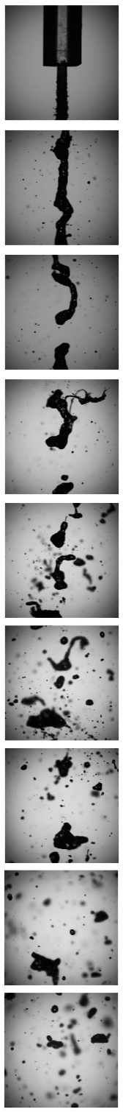

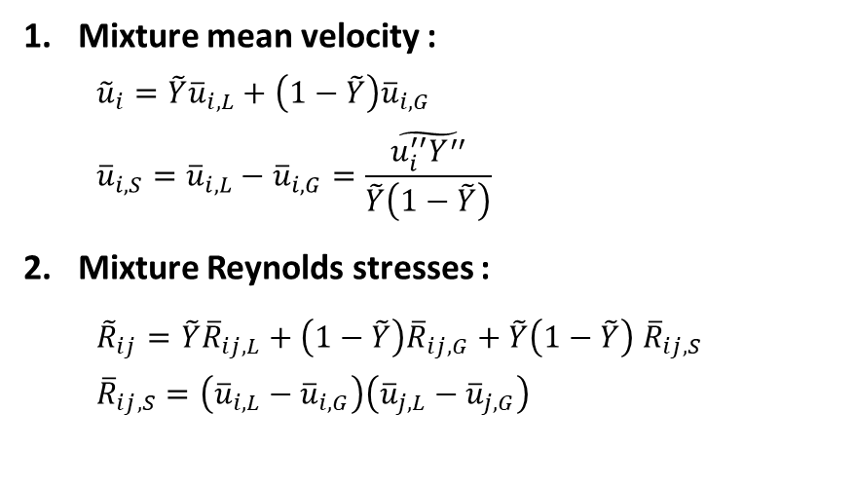
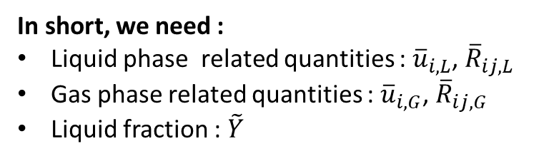
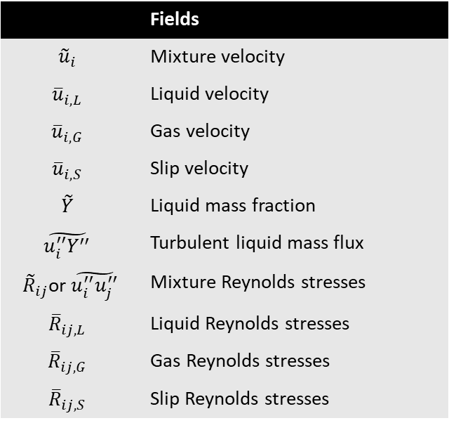
Sprinkler jet atomization
 | Fields
$${\tilde{u}}_{i}$$ | Mixture velocity
$${\overline{u}}_{i,L}$$ | Liquid velocity
$${\overline{u}}_{i,G}$$ | Gas velocity
$${\overline{u}}_{i,S}$$ | Slip velocity
$$\tilde{Y}$$ | Liquid mass fraction
$$\tilde{u_{i}^{′′}Y^{′′}}$$ | Turbulent liquid mass flux
${\tilde{R}}_{ij}$or $\tilde{u_{i}^{′′}u_{j}^{′′}}$ | Mixture Reynolds stresses
$${\overline{R}}_{ij,L}$$ | Liquid Reynolds stresses
$${\overline{R}}_{ij,G}$$ | Gas Reynolds stresses
$${\overline{R}}_{ij,S}$$ | Slip Reynolds stresses
The mixture velocity field
Mixture mean velocity :
  $${\tilde{u}}_{i}=\tilde{Y}{\overline{u}}_{i,L}+\left(1−\tilde{Y}\right){\overline{u}}_{i,G}$$
  $${\overline{u}}_{i,S}={\overline{u}}_{i,L}−{\overline{u}}_{i,G}=\frac{\tilde{u_{i}^{′′}Y^{′′}}}{\tilde{Y}\left(1−\tilde{Y}\right)}$$
Mixture Reynolds stresses :
  ${\tilde{R}}_{ij}=\tilde{Y}{\overline{R}}_{ij,L}+\left(1−\tilde{Y}\right){\overline{R}}_{ij,G}+\tilde{Y}\left(1−\tilde{Y}\right)$ ${\overline{R}}_{ij,S}$
  $${\overline{R}}_{ij,S}=\left({\overline{u}}_{i,L}−{\overline{u}}_{i,G}\right)\left({\overline{u}}_{j,L}−{\overline{u}}_{j,G}\right)$$
In short, we need :
Liquid phase related quantities : ${\overline{u}}_{i,L}$, ${\overline{R}}_{ij,L}$
Gas phase related quantities : ${\overline{u}}_{i,G}$, ${\overline{R}}_{ij,G}$
Liquid fraction : $\tilde{Y}$
“Do or do not, there is no try”
̶ Pr. Yoda
Can we try to get them separately by performing experiments ?

Slide 6
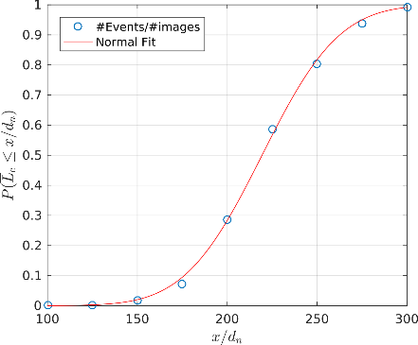
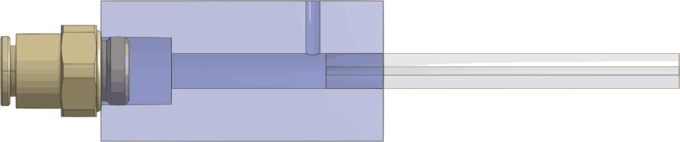
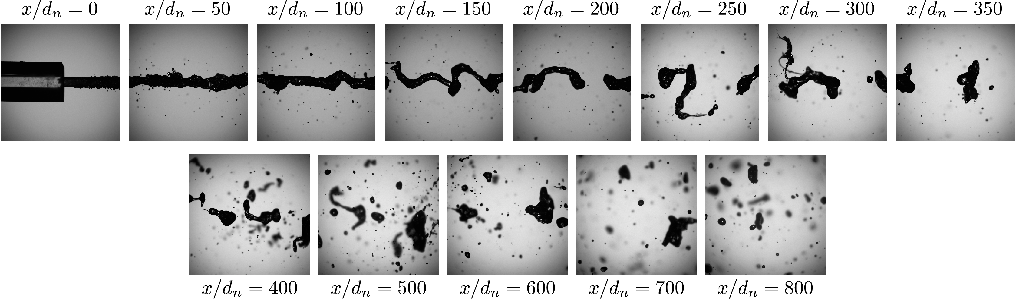
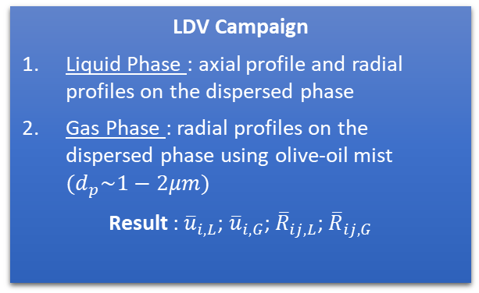
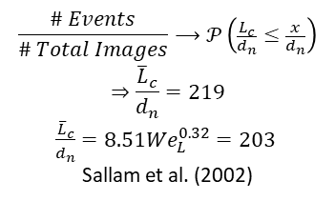
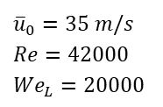
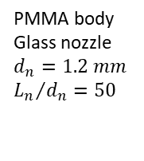
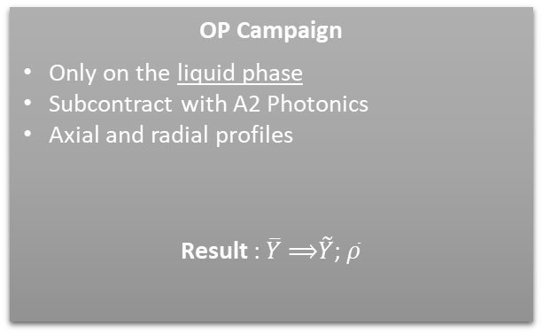
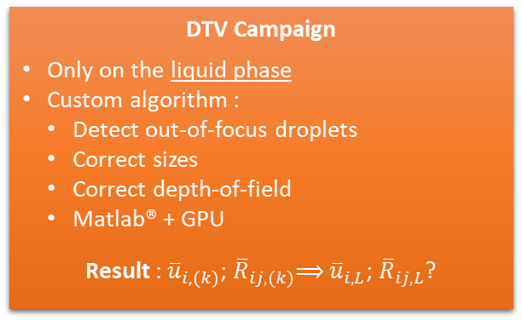
Experimental set-up
$$\frac{\# Events}{\# Total Images}⟶𝒫\left(\frac{L_{c}}{d_{n}}≤\frac{x}{d_{n}}\right)$$
$$⇒\frac{{\overline{L}}_{c}}{d_{n}}=219$$
$\frac{{\overline{L}}_{c}}{d_{n}}=8.51{We}_{L}^{0.32}=203$
Sallam et al. (2002)
Simplified study-case : the round nozzle
PMMA body
Glass nozzle
$$d_{n}=1.2 mm$$
$${L_{n}}/{d_{n}}=50$$
${\overline{u}}_{0}=35 m/s$
$Re=42000$
${We}_{L}=20000$
Dispersed zone
OP Campaign
Only on the liquid phase
Subcontract with A2 Photonics
Axial and radial profiles
Result : $\overline{Y}$ ⟹$\tilde{Y}$; $\overline{ρ}$
LDV Campaign
Liquid Phase : axial profile and radial profiles on the dispersed phase
Gas Phase : radial profiles on the dispersed phase using olive-oil mist $(d_{p}\sim 1−2μm)$
Result : ${\overline{u}}_{i,L}$; ${\overline{u}}_{i,G}$; ${\overline{R}}_{ij,L}$; ${\overline{R}}_{ij,G}$
DTV Campaign
Only on the liquid phase
Custom algorithm :
  Detect out-of-focus droplets
  Correct sizes
  Correct depth-of-field
  Matlab® + GPU
Result : ${\overline{u}}_{i,(k)}$; ${\overline{R}}_{ij,(k)}$⟹ ${\overline{u}}_{i,L}$; ${\overline{R}}_{ij,L}$?

Slide 7
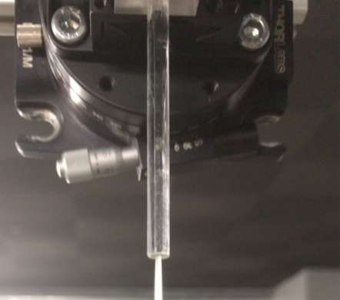
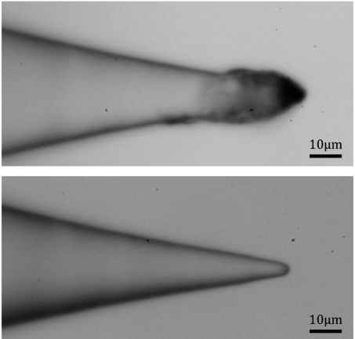
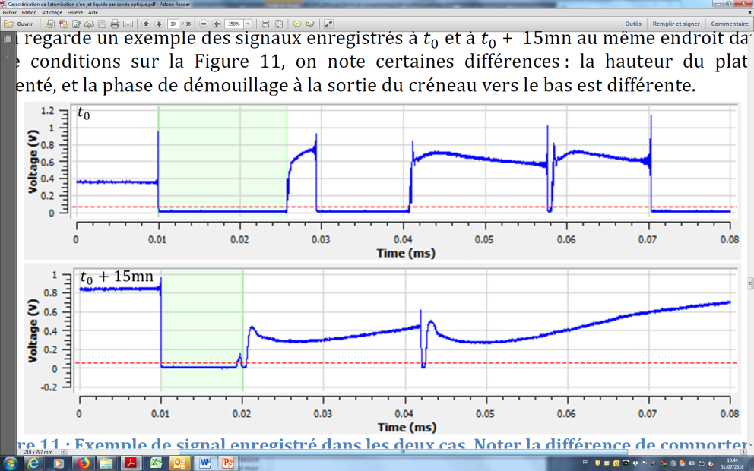
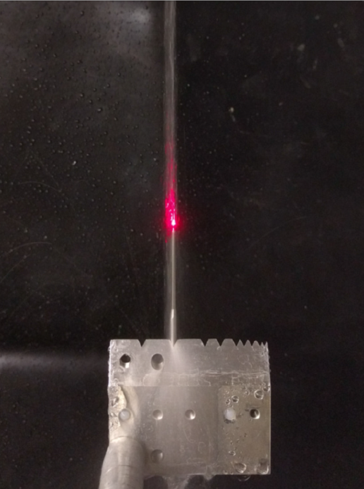
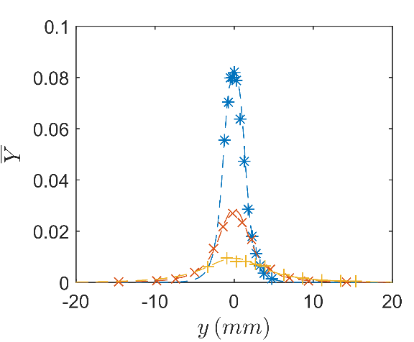
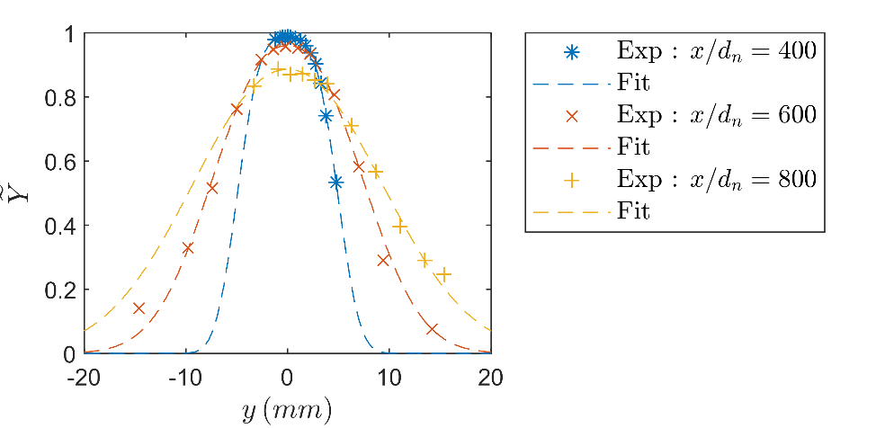


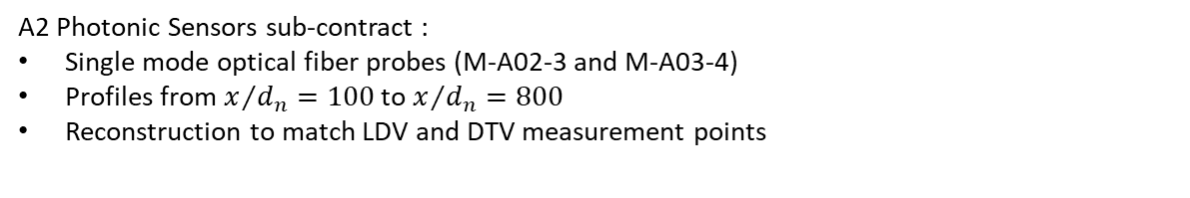
OP Campaign
Measurements set-up and results
A2 Photonic Sensors sub-contract :
Single mode optical fiber probes (M-A02-3 and M-A03-4)
Profiles from $x/{d_{n}=100}$ to $x/{d_{n}=800}$
Reconstruction to match LDV and DTV measurement points
Dirty
Clean
Liquid volume fraction
Liquid mass fraction
$$\overline{ρ}=\overline{Y}ρ_{L }+\left(1−\overline{Y}\right)ρ_{G}$$
$$\tilde{Y}=\frac{ρ_{L }\overline{Y}}{\overline{ρ}}$$

Slide 8
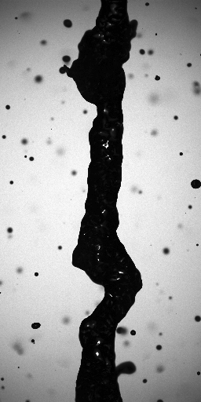
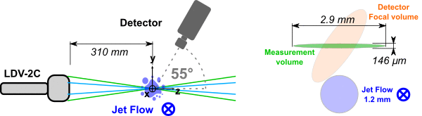
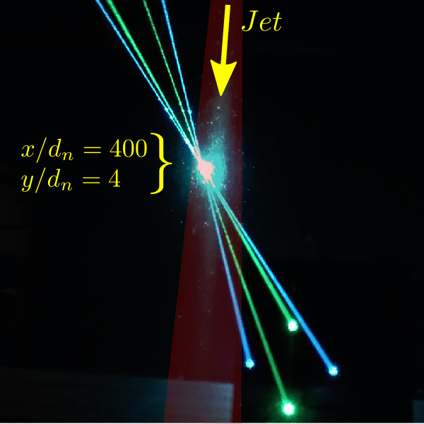
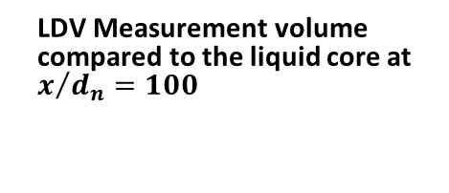
LDV Campaign
LDV Measurement volume compared to the liquid core at $x/{d_{n}=100}$
Measurements set-up : What do we measure ?
LDV-2C Dantec Dynamics
Coherent 306S laser
488 nm @ 1.8 W | 514.5 nm @ 2.8 W
Burst spectrum Analyser (BSA) P60
Two phases – two configurations :
Tracer : | Olive oil mist (gas phase) | Water droplets (liquid phase)
Laser power | 1.1 W | 0.6 W
PM Gain | 1200 V | 600 & 1000 V
SNR | 8 dB | 4 dB
Mychkovsky et al. (2012)

Slide 9
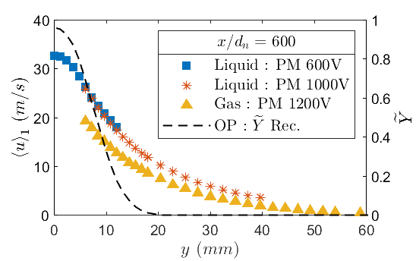
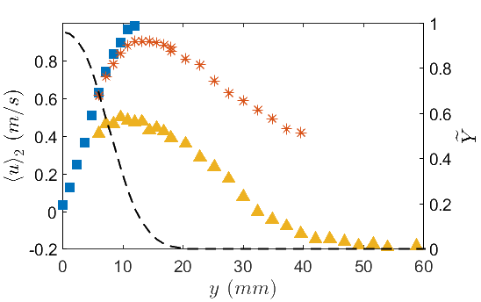
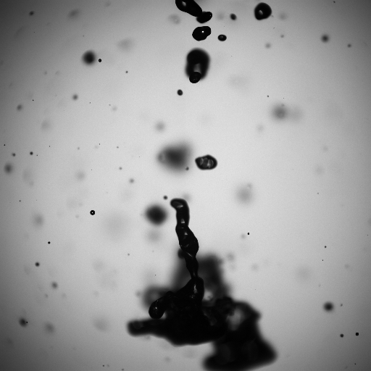
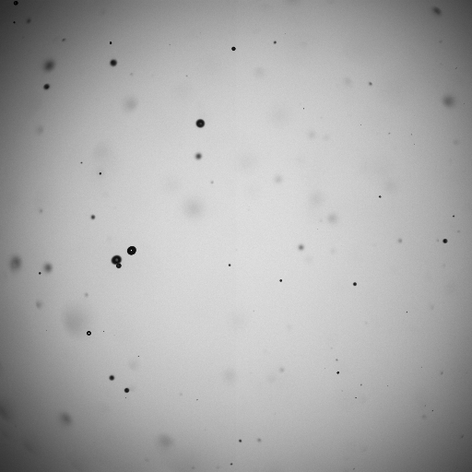
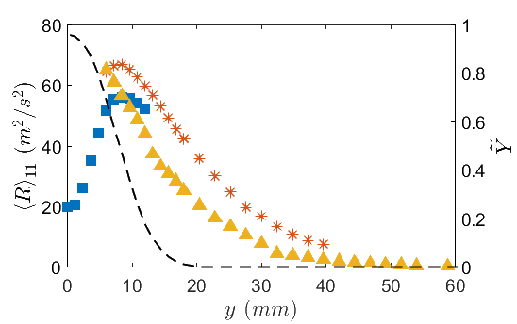
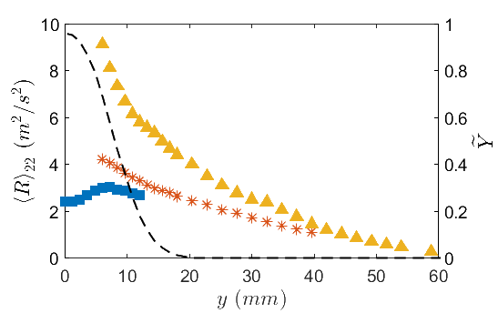
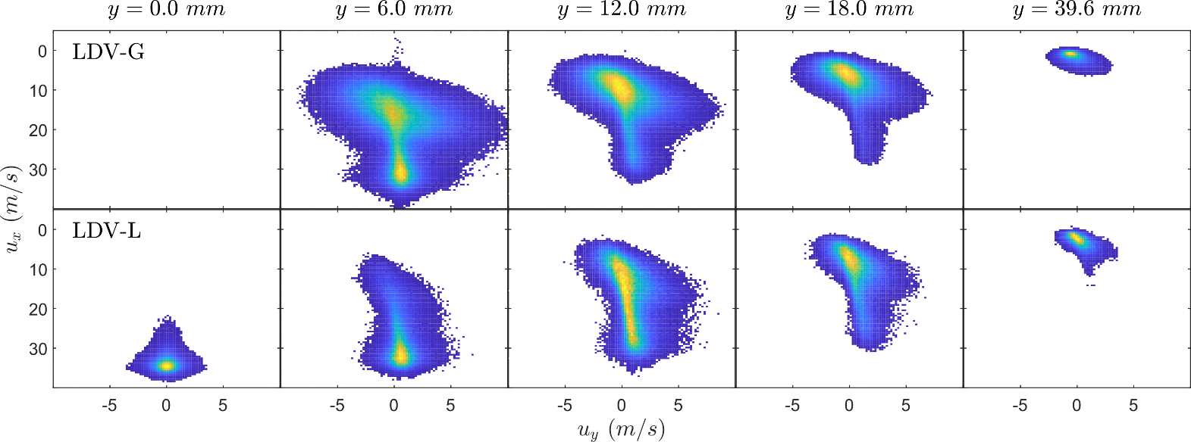


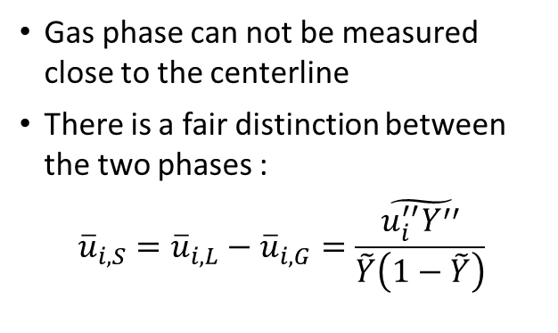
LDV Campaign
Mean radial profiles
Results at x/d_{n} = 600
Shadow images to visualize the flow
$$y=0 mm$$
$$y=19.2 mm$$
Bi-variate histograms
Gas phase can not be measured close to the centerline
There is a fair distinction between the two phases :
$${\overline{u}}_{i,S}={\overline{u}}_{i,L}−{\overline{u}}_{i,G}=\frac{\tilde{u_{i}^{′′}Y^{′′}}}{\tilde{Y}\left(1−\tilde{Y}\right)}$$

Slide 10
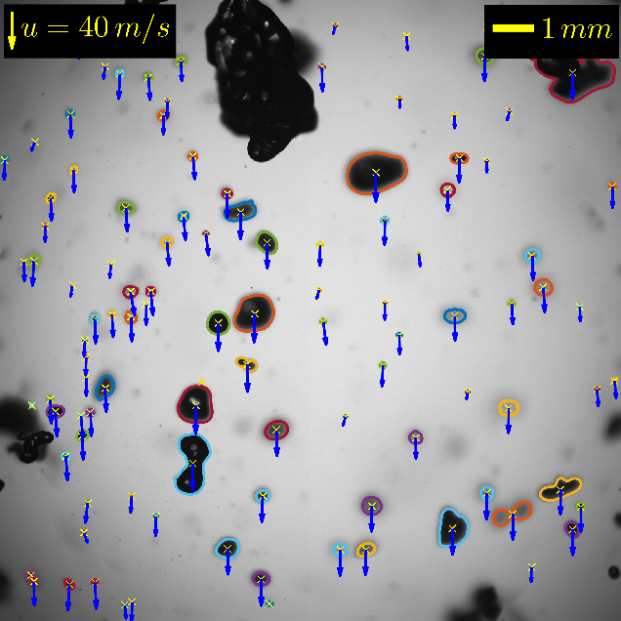
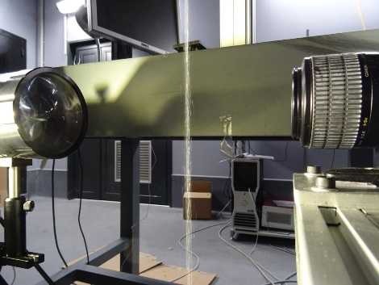
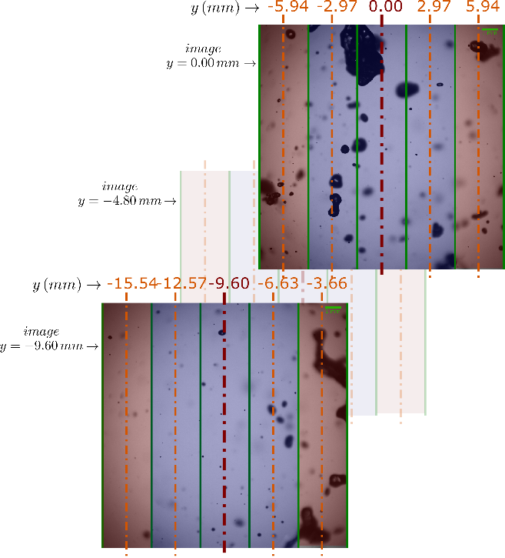
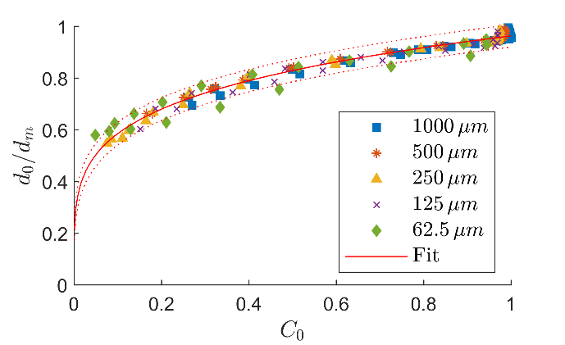
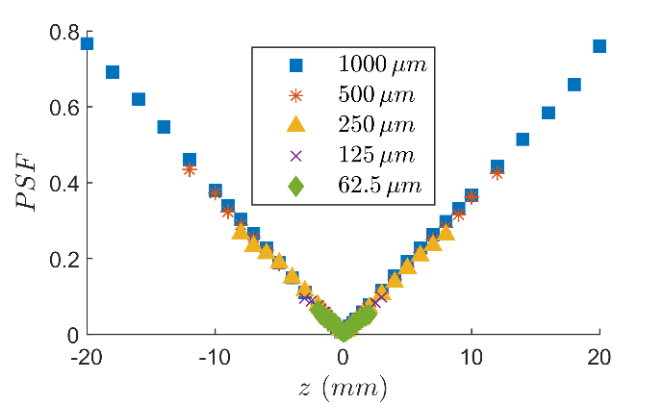







DTV Campaign
Processed shadow image at $x/{d_{n}=600}$
Calibration and post-processing
Experimental set-up
Dantec Dynamics ShadowStrobe system
Double pulsed laser Nd-YAG 135 mJ (532 nm)
HiSense 4M-C CCD camera 12-bit gray-scale double frame images $(5−30 μs)$
Canon MP-E 65 mm f/2.8 macro lens
2048 x 2048 pix @ 139 pix/mm (14.73 × 14.73 mm)
Custom shadow-sizer in MATLAB®
1000 pairs of images per measurement point
Local analysis for contour extractions
High resolution profile reconstruction
Depth-of-Field (DOF) estimation using a calibration target
1) Size correction at $l=61\%$
2) Point-spread-function (PSF)
Size correction is only a function of the normalized contrast $C_{0}$
The measured linear gradient allows to estimate the global DOF
Discarded from the analysis
$${PSF}_{lim}=0.05$$
$$⇒DOF\sim 1,61 mm$$
$$⇒d_{min}\sim 20 μm$$
Fdida & Blaisot (2010)

Slide 11




DTV Campaign
Bi-variate histograms (pdf)
Results at x/d_{n} = 600
Shadow images to visualize the flow
$$y=0 mm$$
$$y=19.2 mm$$
Bi-variate histograms normalized as probability density functions (pdf).
Measurement points similar to the LDV-L and LDV-G.
The overall U-V pdf have a similar behavior between the LDV and DTV techniques.
DTV provides the detailed decomposition per class of droplet sizes.

Slide 12










DTV Campaign
How to reconstruct a liquid-phase velocity field ?
We tried something of the form :
$${\overline{u}}_{i,L}=\frac{1}{\sum_{k}{d_{k}^{n}}}\sum_{k}{u_{k}d_{k}^{n}}$$
Meaning that the liquid-phase mean velocity in a measurement volume is not the arithmetic average over the events.
Results at x/d_{n} = 600
Mean radial profiles by class
Mean radial profiles by measurement technique
Result : Mass conservation is better achieved with n=3
$$Q\left(x\right)=2π\int_{0}^{∞}{r\overline{Y}\left(x,r\right){\overline{u}}_{1,L}\left(r\right)dr}$$
$$Q_{0}=35\left(\frac{m}{s}\right)×A_{n} {(m}^{2})$$

Slide 13





The Mixture Fields
Mixture velocity field :
$${\tilde{u}}_{i}=\tilde{Y}{\overline{u}}_{i,L}+\left(1−\tilde{Y}\right){\overline{u}}_{i,G}$$
Results at x/d_{n} = 600
Significant contribution of the slip-related component:
  $${\overline{R}}_{ij,S}=\left({\overline{u}}_{i,L}−{\overline{u}}_{i,G}\right)\left({\overline{u}}_{j,L}−{\overline{u}}_{j,G}\right)$$
Because of the importance of $\tilde{Y}$, the anisotropy between the principal Reynolds stresses is even bigger than in the liquid phase.
Mixture Reynolds Stresses:
${\tilde{R}}_{ij}=\tilde{Y}{\overline{R}}_{ij,L}+\left(1−\tilde{Y}\right){\overline{R}}_{ij,G}+\tilde{Y}\left(1−\tilde{Y}\right)$ ${\overline{R}}_{ij,S}$

Slide 14









The Mixture Fields
Comparison to numerical model ?
Custom solver implemented in OpenFOAM :
  Mixture two-phase flow
  U-RANS Turbulence : $k−ε$ and $R_{ij}−ε_{ij}$
  3D geometry
Boundary conditions from the real study case
6 MM elements in converged mesh
192 parallel MPI processes at CINES per study case
$${\overline{u}}_{i,S}={\overline{u}}_{i,L}−{\overline{u}}_{i,G}=\frac{\tilde{u_{i}^{′′}Y^{′′}}}{\tilde{Y}\left(1−\tilde{Y}\right)}$$
First order closure:
$$\overline{ρ}\tilde{u_{i}^{′′}Y^{′′}}=−\frac{μ_{t}}{σ_{Y}}\frac{∂\tilde{Y}}{∂x_{i}}$$
Mixture velocity at $x/{d_{n}}=600$
Liquid mass fraction at $x/{d_{n}}=600$
Quasi-multiphase approach:
$$\frac{∂\overline{ρ}\tilde{{\tilde{u}}_{j}u_{i}^{′′}Y^{′′}}}{∂x_{j}}−\frac{∂}{∂x_{j}}\left(\frac{μ_{t}}{σ_{F}}\frac{∂\tilde{u_{i}^{′′}Y^{′′}}}{∂x_{j}}\right)=$$
$$−C_{F1}\overline{ρ}\tilde{u_{j}^{′′}Y^{′′}}\frac{∂{\tilde{u}}_{i}}{∂x_{j}}−C_{F2}\overline{ρ}\tilde{u_{i}^{′′}u_{j}^{′′}}\frac{∂\tilde{Y}}{∂x_{j}}−C_{F3}\overline{Y^{′′}}\frac{∂\overline{p}}{∂x_{i}}+C_{F4}{\overline{F}}_{Drag,i}$$
Same gradient diffusion model for the turbulent mass flux
$R_{ij}−ε_{ij}$ is much closer to the experimentally reconstructed mixture field
Beau (2006)

Slide 15

Water round jet atomization of a large-scale pressure-atomized spray
F. FELIS, S. TOMAS, A. VALLET, M. AMIELH, F. ANSELMET
Merci !

